Slide 1


RES: INVESTMENT POTENTIAL OF KAZAKHSTAN

Slide 2

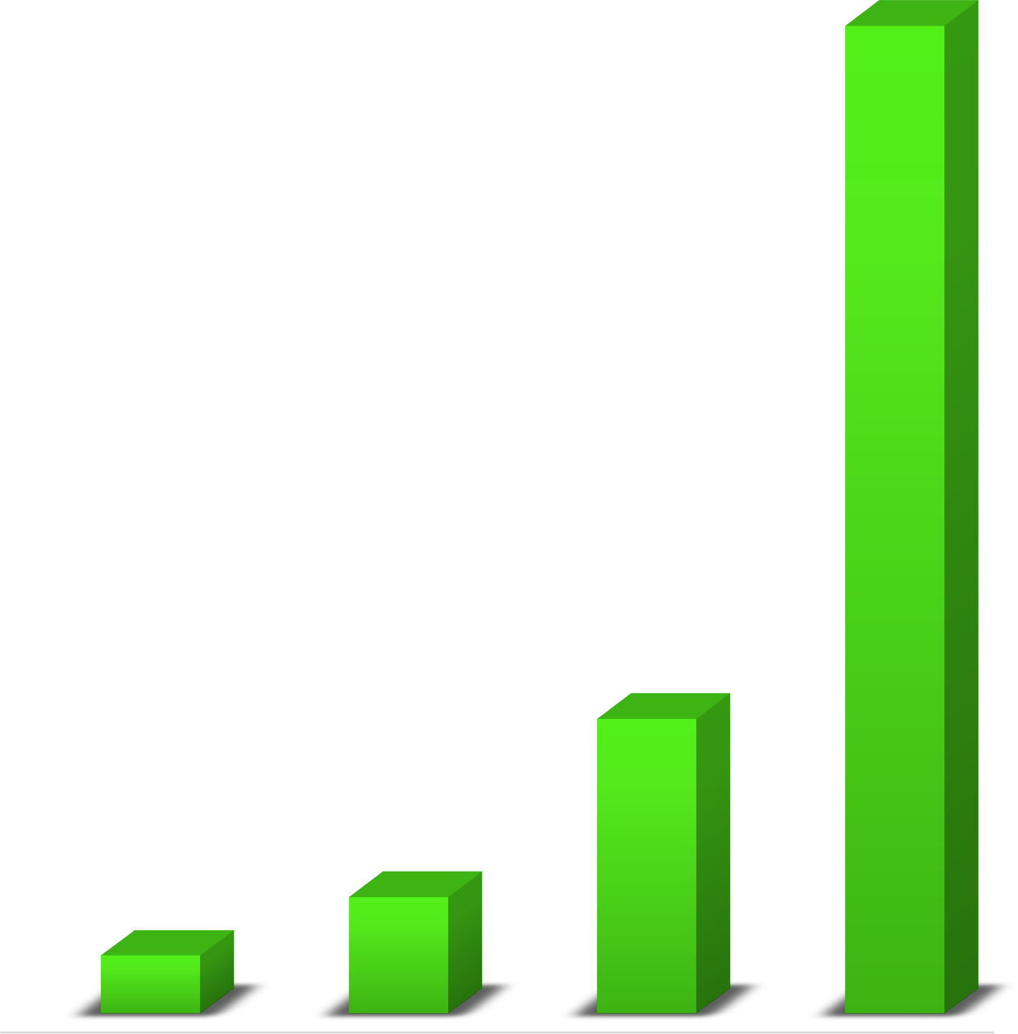


KEY INDICATORS OF RES DEVELOPMENT
" KAZAKHSTAN – 2050 " STRATEGY
THE CONCEPT OF TRANSITION TO A "GREEN ECONOMY "
STRATEGY FOR ACHIEVING CARBON NEUTRALITY
EUROPEAN "GREEN DEAL" - CARBON TAX ADJUSTMENT MECHANISM
KEY INDICATORS OF RES DEVELOPMENT:
50%
THE PARIS AGREEMENT
Reduction of greenhouse gas (GHG) emissions in 2030 by 15% compared to 1990 levels.
15%
6%
3%
2020 2025 2030 2050

Slide 3



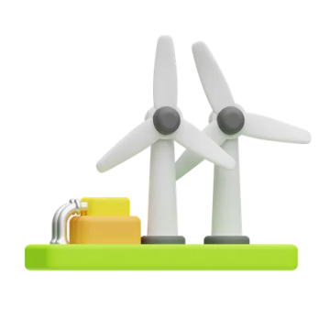


CURRENT RES INDICATORS
2013
MECHANISM OF FIXED TARIFFS
2017
MECHANISM OF AUCTIONS
2020
3 % OF RES IN TOTAL ELECTRICITY GENERATION
2009
2019
2018
THE FIRST AUCTION
PROJECT AUCTIONS
LAW ON SUPPORT FOR THE USE OF RES
RES POTENTIAL
WIND POTENTIAL
920 billion kWh/ year
HYDRO POTENTIAL
62 billion kWh/ year
GEOTHERMAL SOURCES
4.3 billion kWh/ year
CURRENT SITUATION
(share of RES – 5,8 %)
SOLAR POTENTIAL
2.5 billion kWh/ year
TOTAL CAPACITY
2525MW
WPP
1 108 MW
SES
1148 MW
HPS
270 MW
BGP
2 MW
Source: Ministry of Energy of the Republic of Kazakhstan

Slide 4
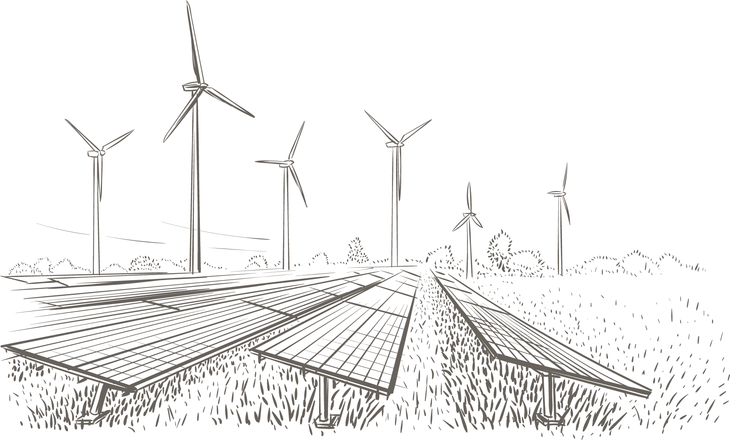

RES SUPPORT
1
Purchase of electricity – SFC of a 20-year-old PPA at an auction tariff in tenge
2
Indexation of RES tariff taking into account inflation and devaluation
3
Exemption from payment of services for the transmission of electricity from RES
4
Priority dispatching of electricity
5
Investment preferences within the framework of the Entrepreneurial Code

Slide 5
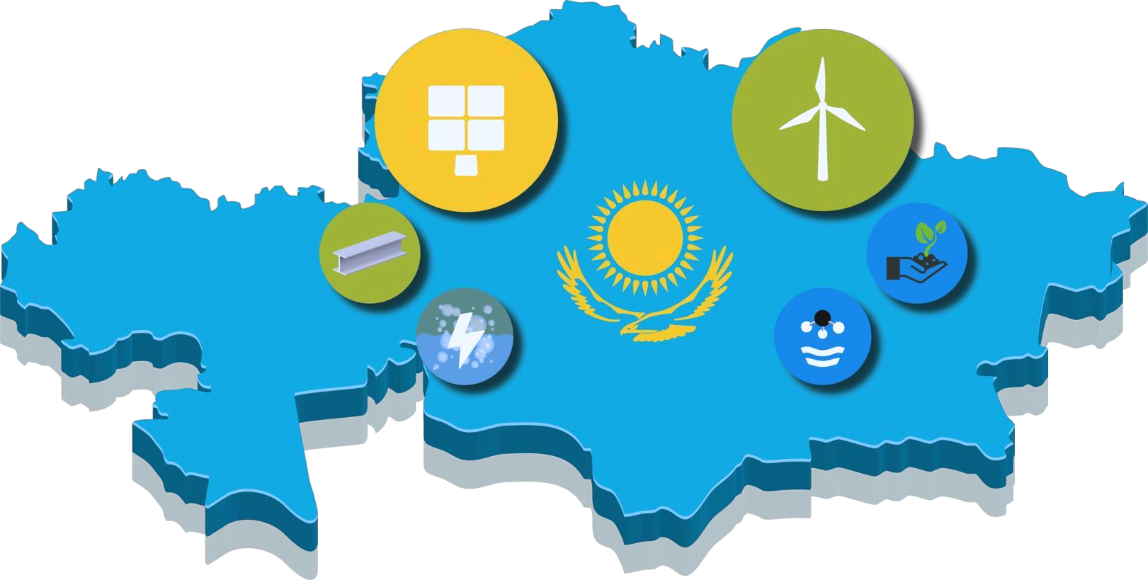

CURRENT SITUATION IN KAZAKHSTAN
5 INVESTMENT PROJECTS FOR THE PRODUCTION OF "GREEN" HYDROGEN ARE PLANNED TO BE IMPLEMENTED IN KAZAKHSTAN
TOTAL CAPACITY more than
2 MILLION TONS PER YEAR
Н₂
SVEVIND
2 MILLION TONS PER YEAR

Slide 6
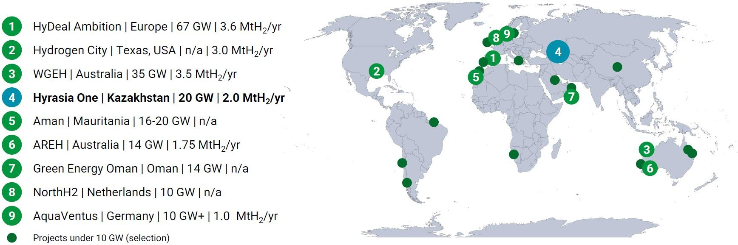
GLOBAL GREEN HYDROGEN PRODUCTION PROJECTS

Slide 7
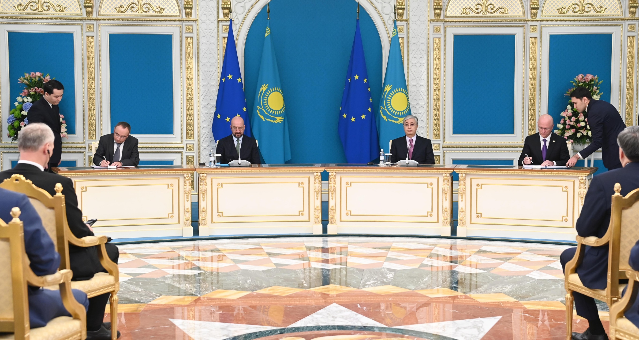

SVEVIND AB – HYRASIA ONE
Svevind plans to produce 2 million tons of “green” hydrogen per year in Kazakhstan for domestic consumption and export to the EU. Subsequently, the company will build renewable energy facilities with a capacity of 40 MW
INVESTMENT AGREEMENT WAS SIGNED BY THE EUROPEAN PROJECT’S DEVELOPER AND THE GOVERNMENT OF THE REPUBLIC OF KAZAKHSTAN IN THE PRESENCE OF THE PRESIDENT OF THE REPUBLIC OF KAZAKHSTAN AND THE PRESIDENT OF THE EUROPEAN COUNCIL

Slide 8
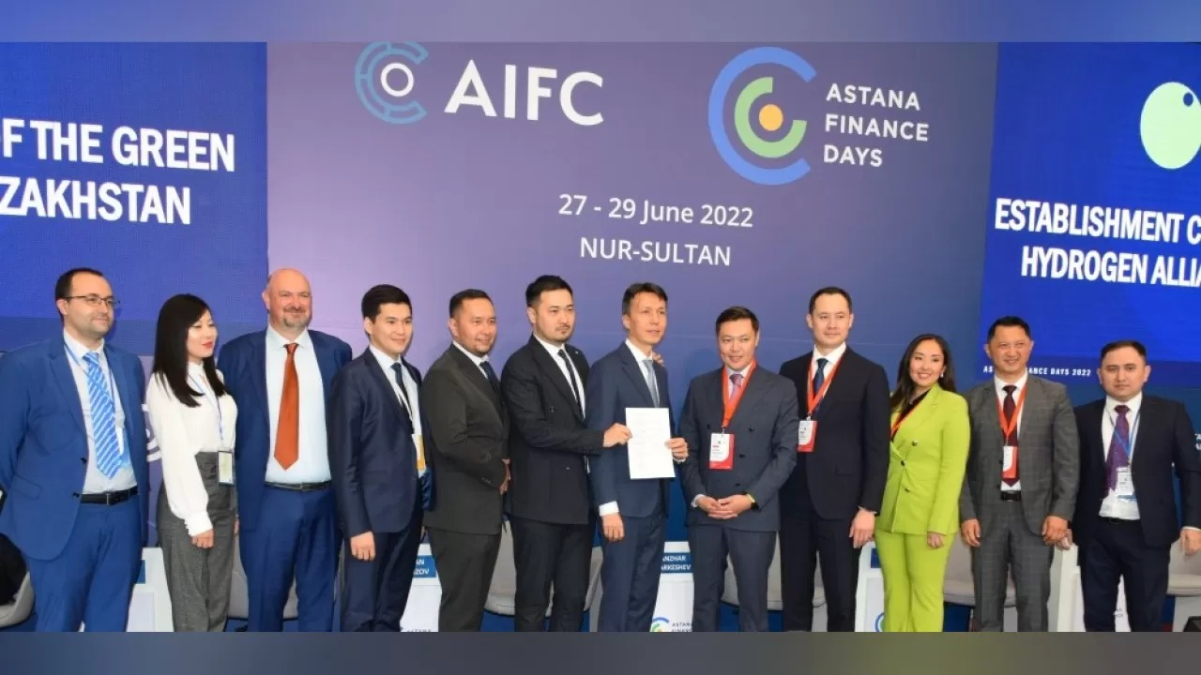
ALLIANCE OF “GREEN” HYDROGEN
Among the founders of the Association were Linde (Germany), Svevind Energy Gmbh (Germany), Roedl & Partners (Germany), Qazaq Gaz (Kazakhstan), Atasu Group (Kazakhstan), Green Spark LTD (Italy), AIFC Green Finance Center (Kazakhstan), GCA Partners (Kazakhstan), Ajusa Hydrogen Technologies (Spain) and other international companies from the EU
THE AGREEMENT ON CREATION OF ALLIANCE OF “GREEN” HYDROGEN OF KAZAKHSTAN WAS SIGNED ON JUNE 29, 2022 IN AIFC AT THE FIRST FORUM ON “GREEN” HYDROGEN

Slide 9


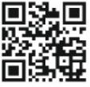
+7 7172 620 620
www. invest.gov.kz

