Slide 1
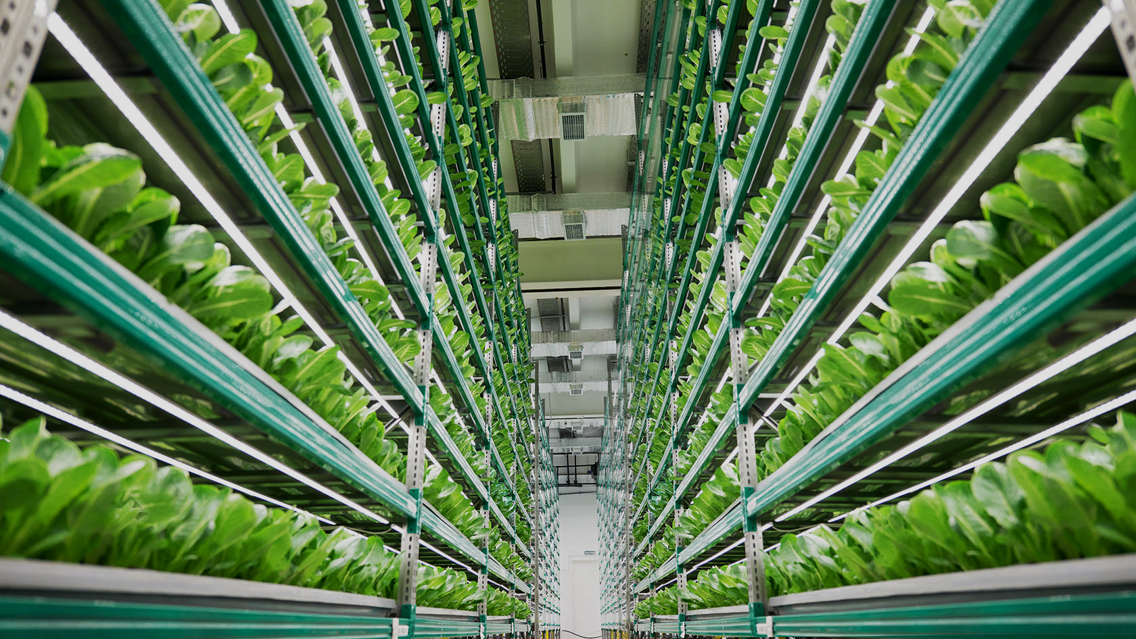
Qazaq Innovation Farm Project
Notes:
Entered text
Goal & Objectives of QIFarm Project
Manufacturing the IoT-driven VF systems to provide OIC countries with fresh and healthy food while reducing waste and optimizing the consumption of available resources
Minimising the price of our vertical farming systems to make them reasonable not only for large scale farming, but also for medium and small projects.
Manufacturing all components of vertical farming systems to be 100% made in Kazakhstan then transfer the technology to OIC countries.
To be a leader in vertical farming industry by providing a bespoke and comprehensive solution to every customer from OIC countries.

Slide 2

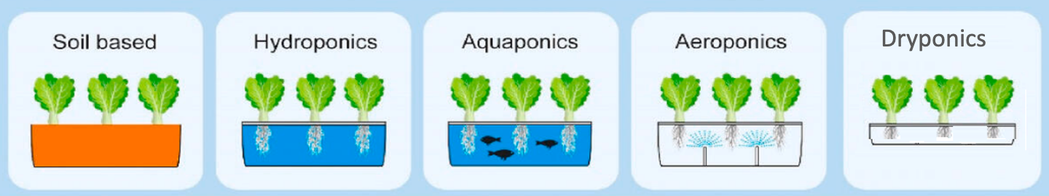

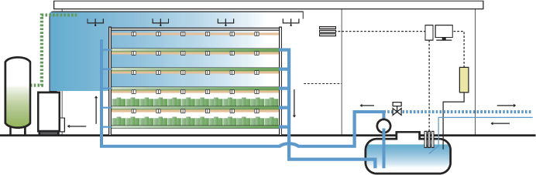
Vertical Farm Cultivation Types
LED Grow Light
Drain Tube
Environmental control
CO2
IoT
QIFarm
Nutrient Pump
Air Conditioner
Water Tank

Slide 3
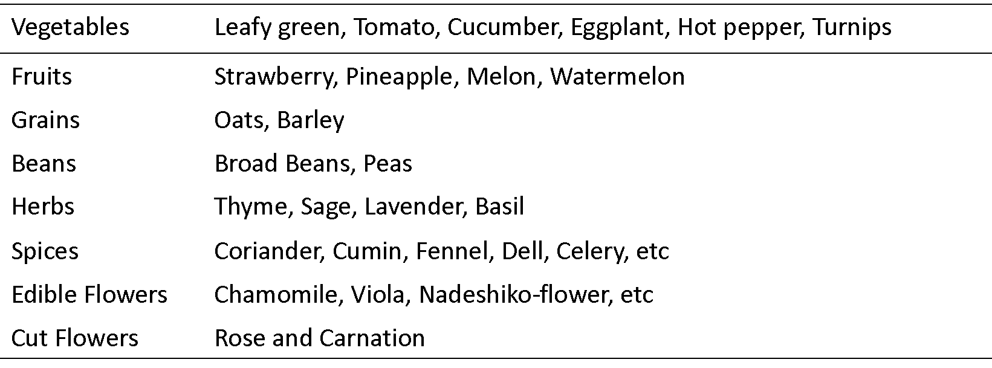

Plants successfully grown by QIFarm Team hydroponically

Slide 4






Main Vertical Farming Components
METAL
PLASTIC
Rack: main frame (aluminum is preferred )
Water Flow System: growing tray, pipes, control/safety valves, tank
CHEMICALS
SEEDS
Fertilizers: Minerals & Ammonia for Nutrient Recipe
Develop highest quality seeds within Kazakhstan
IoT
LIGHT
Climate Control: Sensors, Software/Hardware, Fans, Cameras, etc)
LED: Quantity (intensity), Quality (Spectrum/recipe), Time ( Duration)

Slide 5
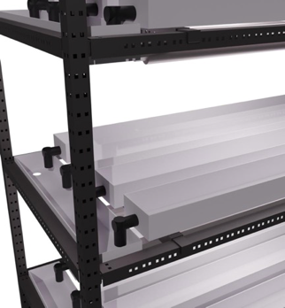
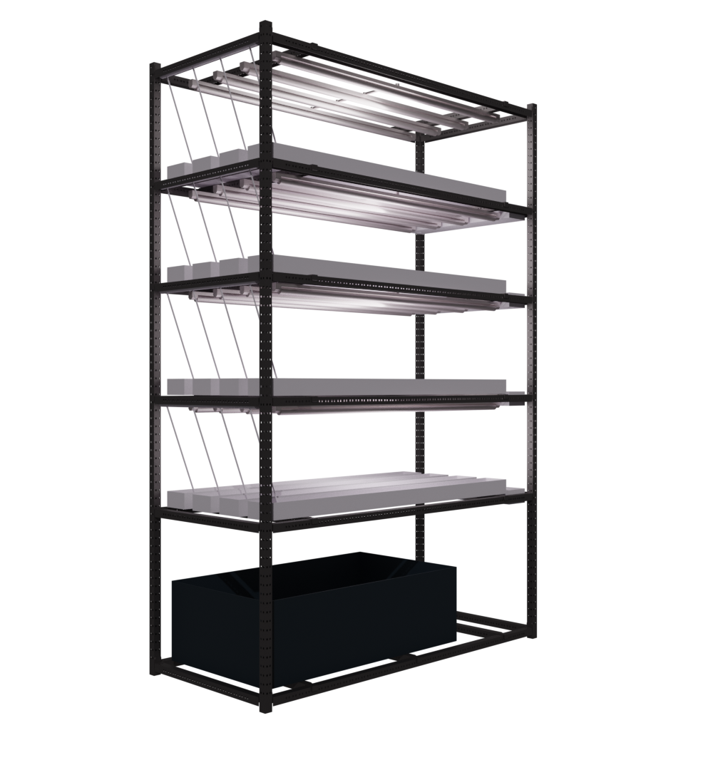
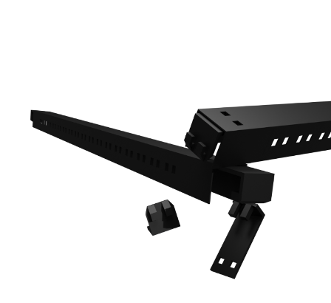
Features of QIFarm’s equipment
100% OIC novel and state of art design
Dynamic structure (for building all system, adding or removing new parts)
Easy to assemble
Size adjustability
Light weight for logistic transport (all in one box)
Competitive price

Slide 6

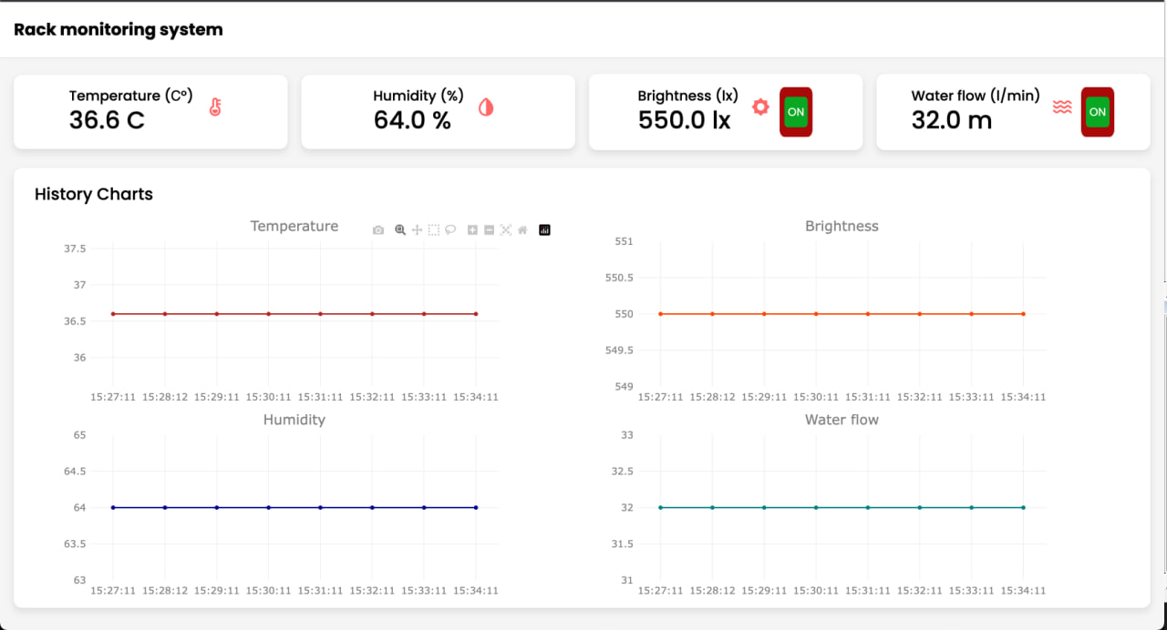
IoT system

Slide 7
Why do OIC countries need to develop VF?
Food security
Health and nutrition
Sustainable agriculture
Land constraints
Urbanization and population growth
Climate change resilience
Global position
Economic growth
Economic structure diversification
Technological advancement

Slide 8
SWOT Analysis of
Vertical Farming Business
Strengths
Weaknesses
Opportunities
Threats
Pesticide free crops
Year round fresh crop
Protection from extreme weather
Maximize crop yield
Dynamic scaling H&V
Water conservation and recycling
High initial costs
High demand for energy
High operational costs
A limited number of crops that can be grown economically
Sophisticated skills required
Continuous Urban growth
Solar and wind energy
Automation / IOT/ AI
Advanced technology for pollinating vertically grown crops
Awareness increase
Power outage / cut
Political lobbying of greenhouses
Competition from land crop producers / Price reduction
Restrictions in importing VF components (nutrients, seeds, etc.)

Slide 9
Opportunities of Arranging VF Production: Pilot Project in Kazakhstan
Resource availability with competitive prices
(Metal, Plastic, Chemicals)
Possibility to develop and produce other VF components
(LED, IoT)
Transferability of Technology/Know-How to Kazakhstan
In Kazakhstan
Available manufacturing power of factories
Research power of scientific universities

Slide 10
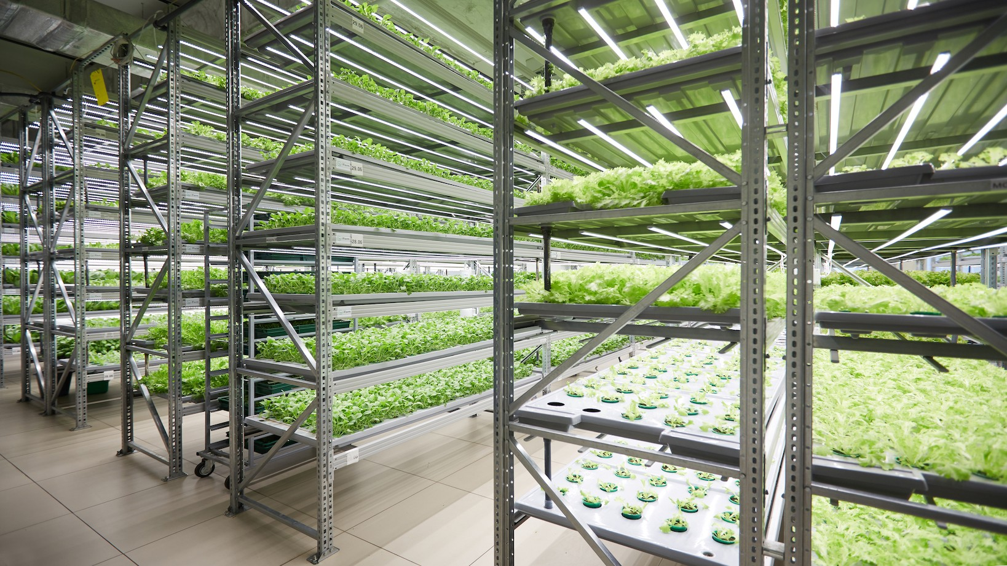
QIFarm Project Goal & Objectives
Manufacturing the IoT-driven VF systems to provide OIC countries with fresh and healthy food while reducing waste and optimizing the consumption of available resources.
Minimizing the price of small , medium, and large scale VF systems
All components to be 100% made in Kazakhstan
Transfer VF technologies to OIC countries.

Slide 11
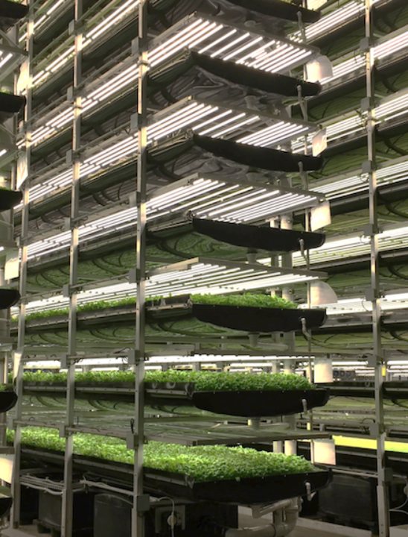
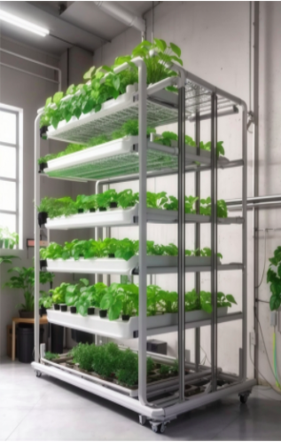
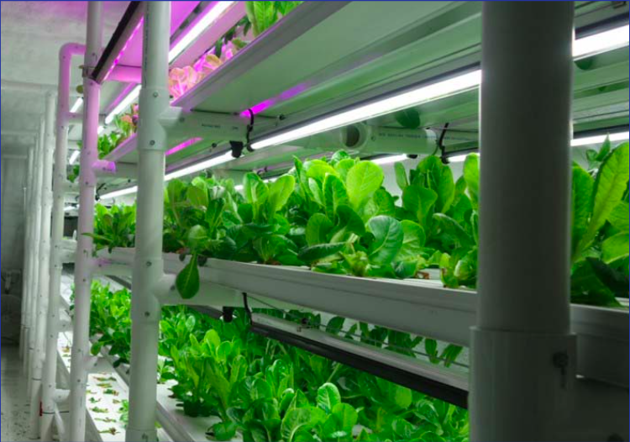
Vertical Farming
Firm Model
Business Support Model
Family
Model
The most comprehensive solution for those who want to make business on selling high quality, fresh and healthy crops.
The size of the farm shall be not less than 100 sq.m.
Depending on business models, labour availability, its costs as well as energy price different equipment and level of automation will be proposed.
Providing customers with a full range of services to launch the farm and get a harvest, including advising on farm design, preparing financial models, installing the equipment, training stuff.
An intermediate solution for those who have a business associated with food such as café, restaurants, hotels, supermarkets or want to add a new line to the existing business.
The model envisages various levels of automation from a manual to a fully sophisticated one.
The size of the farm shall be from 10 to 100 sq.m.
Deploying by the customers the available resources (premises, labour) to provide themselves with ultra-fresh and healthy crops all year round to reduce costs or improve the quality of the sold products or generate a new source of income.
An individual solution for families who are concerned with the quality of their food and have a small space at home, balcony or garage for growing crops.
The size of the farm shall be from 3 to 10 sq.m.
The model also envisages various levels of automation from a very simple (manual, semi-automated) one to a more sophisticated level.
The maintenance and support of the farm could be delegated to the centralized system managed by QIFarm team through IoT solution.
QIFarm Project Models
Vertical Farming Firm Model
For high quality, large quantity of fresh and healthy crops.
More than 100 sq.m.
Family Model
For families who are concerned with the quality of their food (in kitchen, balcony, or garage etc)
This vertical home garden can be sized from 3 to 10 sq.m.
Business Support Model
For a business associated with food such as café, restaurants, hotels, supermarkets etc
Between 10 to 100 sq.m.

Slide 12

Success Indicators
  Availability of main raw materials, including Metals, Plastics, and Chemicals in huge amounts and competitive prices in Kazakhstan
  Possibility of VF Technology transfer including IoT / LED
  Full support of IOFS to export Kazakhstan VF technologies to OIC countries.
  Powerful R&D of Kazakhstan Universities.
  Connection to High Quality seeds and strawberry plants from Japan & Italy.

Slide 13
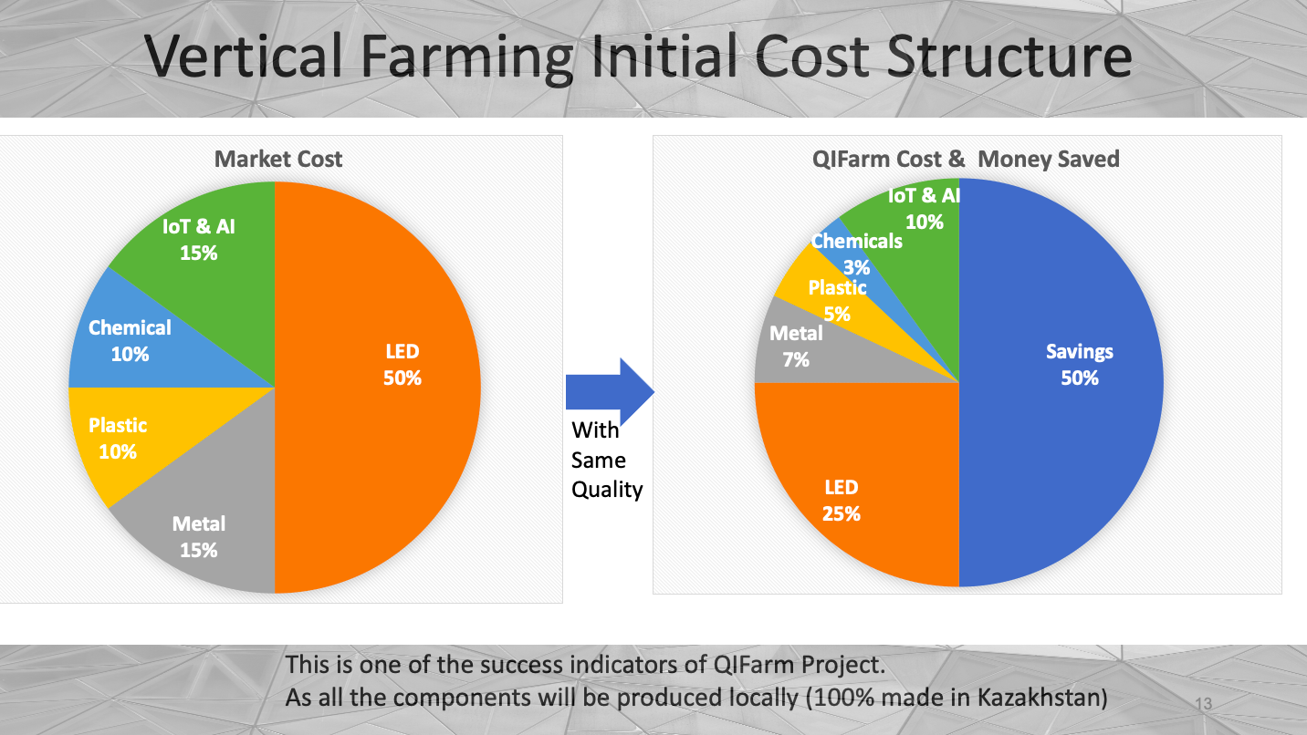

Slide 14



Here is the beginning …
www.transleadia.kz

