Slide 1
Investment climate in renewables in Kazakhstan
November 2023

Slide 2
Legal basis for development of renewables in Kazakhstan
Existing legal norms
Legislation norms since 2021
1
Guaranteed purchase of all electricity produced and supplied to the grid
1
Construction of maneurable (flexible) capacities and stations
2
Distribution of electricity from renewable energy sources through the Settlement and financial center (RFC) to conventional consumers
2
Extension of РРА-contracts from 15 to 20 years
3
Financial support for the Settlement and financial center (RFC) from the Government in case of default
3
Exemption from payment for the transmission of electrical energy
Providing investment preferences (customs and tax) under the Entrepreneurial Code
4
End-to-end tariff for renewables (considering the costs of renewable energy sources as a surcharge over the ceiling tariff)
4
Legislation norms since July 2023
5
Creation of a reserve fund in the Settlement and financial center (RFC)
1
Introduction of Single Buyer model
6
Agreement on connection of RES facilities to the grid
2
Balancing market of electric power
7
Annual indexation of tariffs (depending on the exchange rate and inflation)
Source: Law «On electric energy», Law «On support for RES»

Slide 3
Capacities for auctions on 2023-2027 and starting tariffs for auctions
Planned capacities for auctions on renewables in 2023-2027
Starting auction prices in 2023
Type | 2023 (MW) | 2024 (MW) | 2025 (MW) | 2026 (MW) | 2027 (MW)
SPP | 100 | 100 | 100 | 100 | 100
WPP | 500 | 700 | 800 | 1000 | 1000
Hydro PP | 250 | 560 | 480 | 480 | 450
BioPP | 10 | 10 | 10 | 10 | 10
TOTAL | 860 | 1370 | 1390 | 1590 | 1560
Type | Starting price, KZT/kWh | Starting price, cents USD/kWh
SPP | 34,61 | 7,7
WPP | 22,68 | 5,05
Hydro PP | 41,23 | 9,18
BioPP | 32,23 | 7,18
Source: Ministry of Energy of Kazakhstan
Planned capacities will secure the potential new renewables of 6670 MW ВИЭ until 2032. However there is a lack of understanding of plans of the Ministry of Energy on maneurable capacities development

Slide 4
In 2020 RES were included in the List of Priority Investment Projects, which allowed RES facilities to receive preferences
Investment preferences for Priority investment projects
Tax preferences for Priority investment projects
exemption from customs duties and value added tax on imports
state in-kind grants - the maximum size of a state in-kind grant is no more than thirty percent of the volume of investments in fixed assets of a legal entity of the Republic of Kazakhstan (land plots, buildings, structures, machinery and equipment, computer equipment, measuring and control instruments and devices, vehicles (for excluding passenger vehicles), industrial and household equipment)
According to paragraph 1 of paragraph 2 of Article 290 of the Entrepreneurial Code of the Republic of Kazakhstan, the following tax preferences are provided for priority investment projects:
Reducing the amount of calculated corporate tax by 100%;
Application of coefficient 0 to land tax rates;
Calculation of property tax at a rate of 0 percent
The investment contract establishes the validity period of each type of tax preferences, but not more than the deadline for their application, determined in accordance with the Code of the Republic of Kazakhstan “On taxes and other obligatory payments to the budget” (Tax Code)
Also, the application of tax preferences is canceled in the event of early termination of the investment contract in the manner established by this Code.
Source: Entrepreneurial Code of the Republic of Kazakhstan
The inclusion of RES in the number of priority investment projects was initiated in the Charter - Appeal to the Government of the RES business community following the results of Solar Fest Qazaqstan in July 2019.

Slide 5
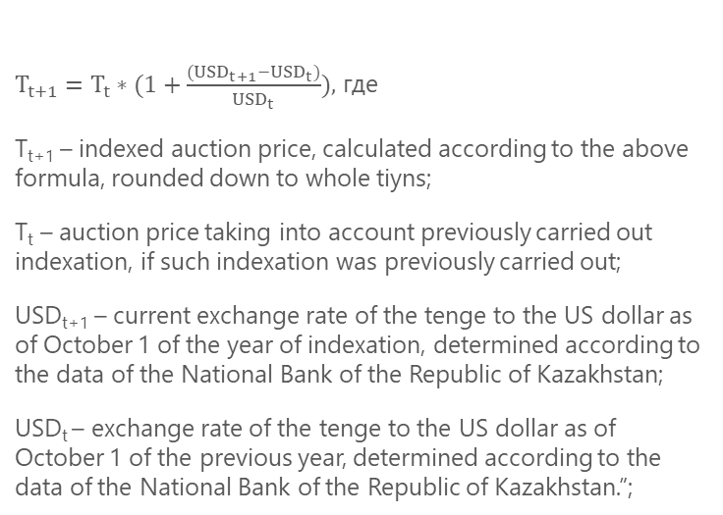
In September 2022 a new mechanism for indexation renewable energy tariffs was adopted
In September 2022 a new mechanism for indexing renewable energy tariffs was adopted
Annual indexation to the consumer price index according to the formula
The new indexing mechanism assumes:
one-time indexation of auction prices for the construction period by 100% changes in the exchange rate of the national currency to the US dollar
annual indexation of auction prices with the choice of an indexation formula (either by the consumer price index or by changes in the exchange rate of the national currency to the US dollar) once when concluding a purchase agreement for the entire period of its validity
$T_{t+1}=T_{t}∗(1+\frac{{(USD}_{t+1}−{USD}_{t})}{{USD}_{t}}),$ где
T_{t+1} – indexed auction price, calculated according to the above formula, rounded down to whole tiyns;
T_{t} – auction price taking into account previously carried out indexation, if such indexation was previously carried out;
USD_{t+1} – current exchange rate of the tenge to the US dollar as of October 1 of the year of indexation, determined according to the data of the National Bank of the Republic of Kazakhstan;
USD_{t} – exchange rate of the tenge to the US dollar as of October 1 of the previous year, determined according to the data of the National Bank of the Republic of Kazakhstan.”;
Т t+1 = Тt * ИПЦ, где
Т t+1 – indexed auction price, calculated using the above formula, rounded down to whole tiyns;
Тt – auction price taking into account previously carried out indexation, if any was previously carried out;
ИПЦ – consumer price index accumulated for the twelve months preceding October 1 of the year of indexation, determined according to the data of the authorized body in the field of state statistics

